Slide 1
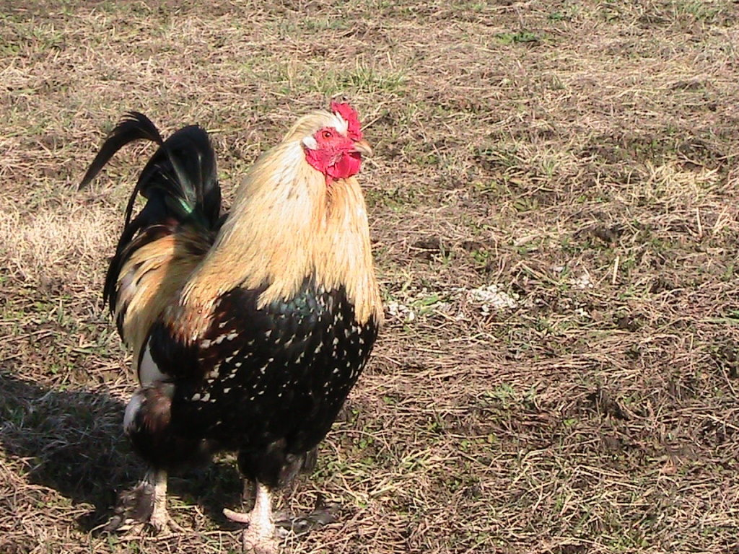
Urban Chickens
Presented by:
Gary & Elizabeth Wenig
Rocky Creek Valley Farm
Rayville, MO

Slide 2
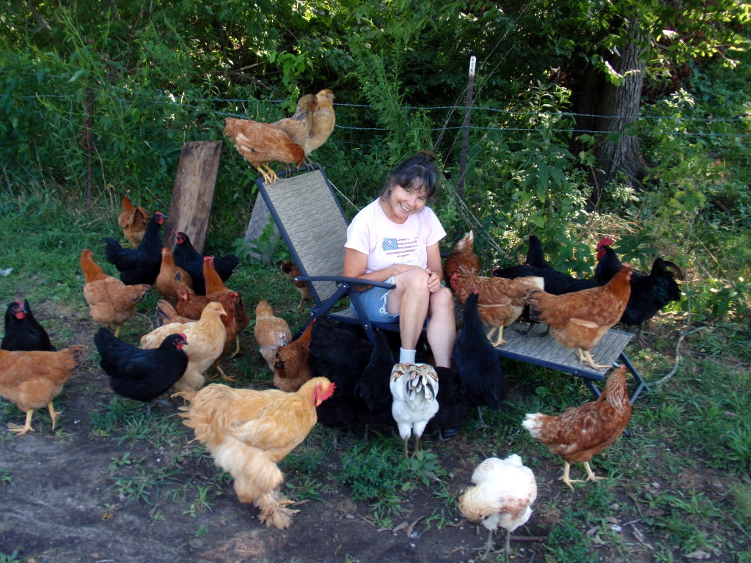
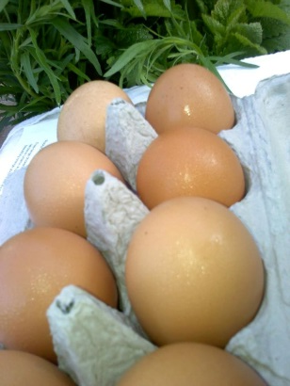
Urban Chicken Focus Topics
IPM – Integrated Pest Management
Legislation
Emergency Rescue
Care and Feeding
Pens & Coops
Eggs
Chicken Breeds
Notes:
Review outline
At some point your will testify in court or be asked your opinion on legislation.
You will probably be asked to provide an opinion to the city council, your need a broad overview of chickens so you can do your own research.
I raised 30,000 broilers, worked at Swift Poultry processing plant, caught chickens 3+ nights a week, vaccinated and caught turkeys weekly – I hated chickens until we started raising heritage breeds – there is no comparison.
Containment chickens have breed down to the IQ of a rock.
If you have a question Google it, you can get any answer you want, it may not be right.
These are our opinions based upon University research and USDA trials, even they do not agree, we try to just use common sense.
There is little to no scientific date on this subject, as we made the move to containment housing all data was lost.
The closest most of your city councilmen have been to a chicken is Chic-fil-A.

Slide 3
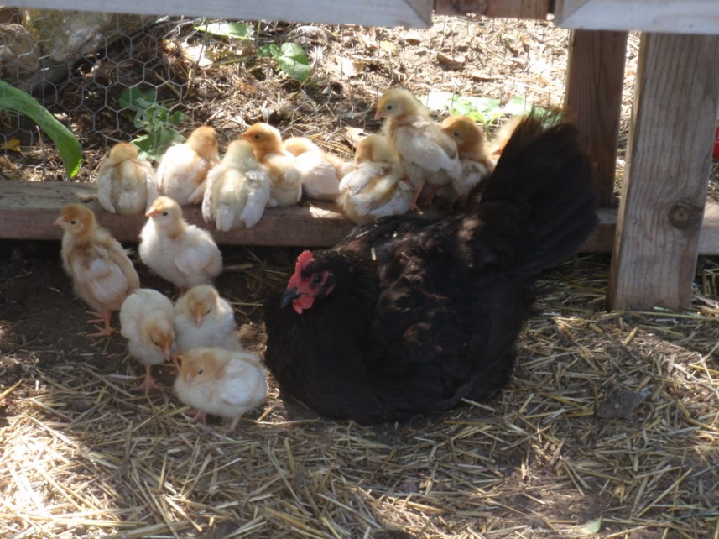
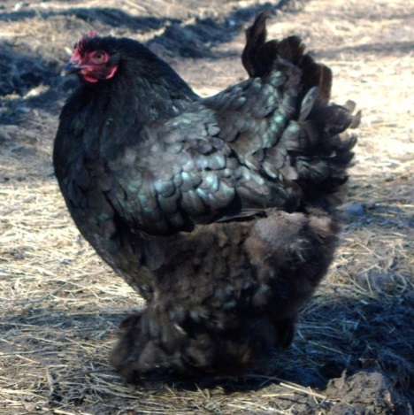
Quick Survey
Does your city currently allow chickens?
Does your city have ordinances against back yard chickens?
How many of you have or would like to have a few chickens?
Are you completely opposed to back yard chickens?

Slide 4
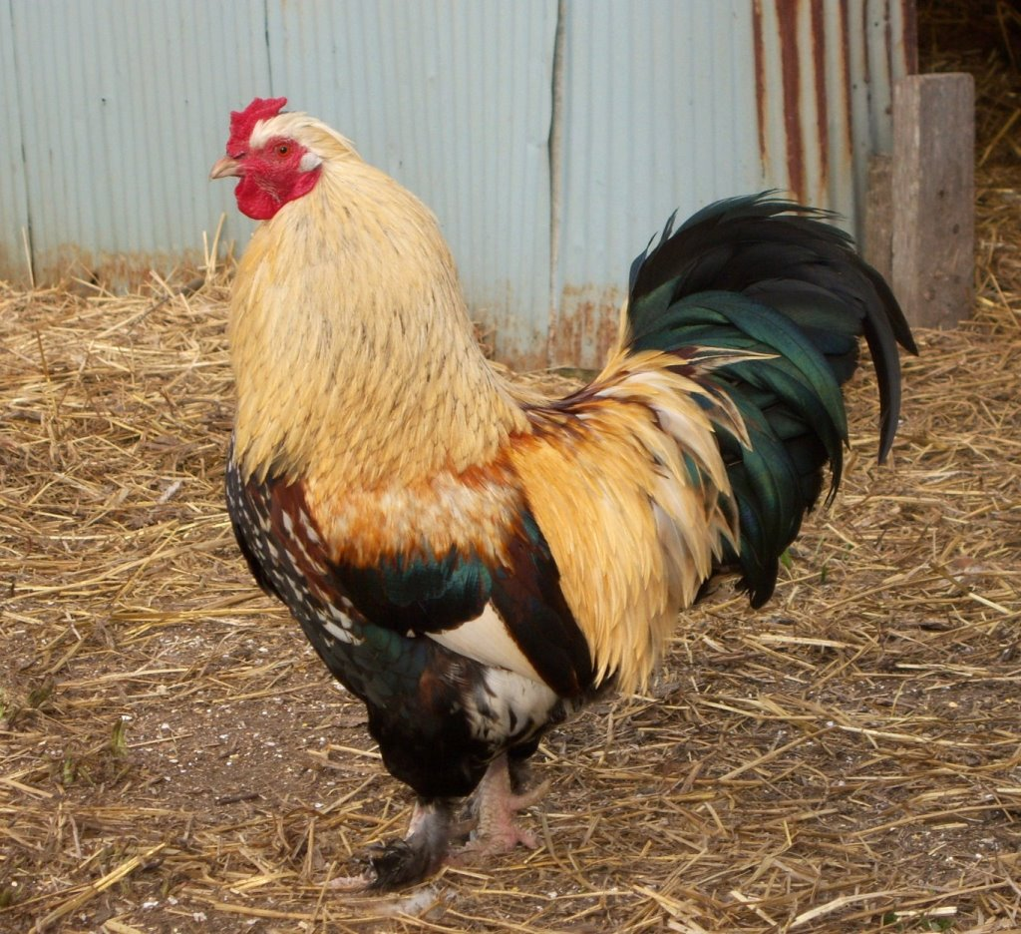
Legislation & City Ordinances
History of the ordinances
Roosters will crow, even more if in competition
Culling is not perfect (5 to 10% roosters), you will need a disposal system in place
Fences and containment
Some breeds fly others do not, 6’ fence minimum, wood or wire?
No reason for an internal second fence
Shelter is a must, shade and varmint protection
Number of hens per sqft
There are virtually no university studies or scientific data on the subject
All the historical data was discarded with the move to containment housing
Fecal matter issues
Phosphates & disease
Notes:
History - My Russian friend’s story, 50,000 pigs in Manhattan in 1859 and they spent all night removing the horse manure from the streets.
Roosters - Squawking after laying a few seconds is averaged at 63 decibels, or about the level of two people talking.
Fences - Wood fences so the neighbors dog can’t see the chickens, chickens are more likely to fly over wire because they can see the other side.
Fences - Chickens cannot see very far, and will not fly over if they cannot see the top.
Fences - Chickens do not bite.
Fences - If a chicken gets out the most it will do is scratch in the flower bed or eat tomatoes.
Hens per sf -
As pets - Kids therapy & responsibility - Drumm Farm Center for Children.

Slide 5
Manure Concerns
Chickens
Dogs
Excreta per chicken per day - 1.4 oz/day or 9 oz/week which means 4 hens would put out 39.2 ounces in a week or just under 2.5 pounds per week (adjusted for urine 6 chickens is less than 1 small dog)
The average percentages (per total weight) of chicken manure is: 1.8% nitrogen, 1.5% phosphate, and 0.8% for potash
If every house in a city with 20,000 homes had 6 chickens it would be less manure than 1 commercial broiler house produces
Manure from 4 Layers = Nitrogen 0.50, Phosphate 0.50, Potash 0.35, Sulfur 0.05 lb / yr considered to be 2-2-1
The average size dog produces about ½ lb / day (3.5 wk) Dog poo contains pathogens
Recent DNA studies show that 95 percent of the bacteria fecal coliform in urban watersheds comes from dogs
A dog produces 23 million fecal coliform bacteria / g of feces, or 10 times that of a cow.
Dogs generate 10 million tons per yr = 267,500 tractor trailers full, trucks bumper to bumper 3,800 miles and that doesn't count urine
40 lb (16.7 cu ft) of composted manure per 100 sf garden – 1 chicken generates 34.7 lb of manure or 2 cu ft of compost per yr = 8.35 chickens to generate ( 15 is more realistic)
Lawn care service is putting approx. 3 to 15 lb of phosphate on your lawn per year - 4 chickens 0.50
Notes:
Start - Chickens do not urinate so their excrement also contains their urine where as dogs, cats, cattle, etc. it is separate , water to feed is 2 to 1.
There is a substantial difference in the excreta from commercial hens and free range hens.
After chicken – to make fertilizer - 3 chicks at 2.5 lb/wk = 98 lb/yr, 18 chickens to equal 100# of 12-12-12 fertilizer.
After dog - In general every household in your jurisdiction could get 6 to 8 hens and it would not come close to the dog and cat poo totals of the city.
What percentage of residents are actually going to get chickens? One out of a couple of hundred homes.
Your problem will not be in middle and upper class neighborhoods because they have the money to spend on proper care.
End - Story from forum about poultry hearings and neighbors dogs.

Slide 6
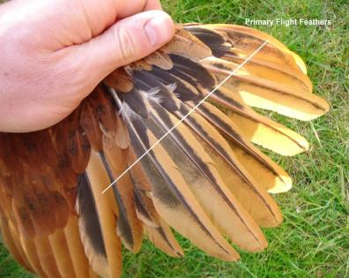
Emergency Rescue
Catching the birds
Wait until after dark when they roost
Pick them up by the body holding the wings down, never the feet
Emergency first aid – you must separate injured birds or the other hens will kill them, cannot have any sign of blood on them
Never clip their beaks, they can no longer forage properly
Wet soil/mud causes lots of problems
Clipping wings for problem hens, learn to do it correctly
Emergency containment – don’t forget they can fly
Notes:
Gary - Story about chickens to widows in poor countries.

Slide 7
Parasite Control
Preventative
Fresh water daily
Wash water pans once a week with white vinegar
Add apple cider vinegar to drinking water once a week
Add chopped nettles to feed once a week
Raw curdled milk: 50 mls per bird
Horseradish leaves, garlic tops, wormwood, tansy, elder leaves, carrots, and the seeds of mustard, pumpkin and nasturtium
Mix diatomaceous earth into food once a week and scatter it throughout the chicken house.
If you are already infested:
Feed 2 cloves garlic per bird or crush a bulb of garlic per gallon, secure in muslin, place in drinking water for about 10 days
For a sick bird with sever infestation: ½ c wormwood tips, ½ c tansy, 1 comfrey leaf, 1 chopped garlic clove, 1 cup oats. Mix with water to make thin paste and feed every other day for 6 days — do not give the bird any other food.
Notes:
Play Mite video

Slide 8
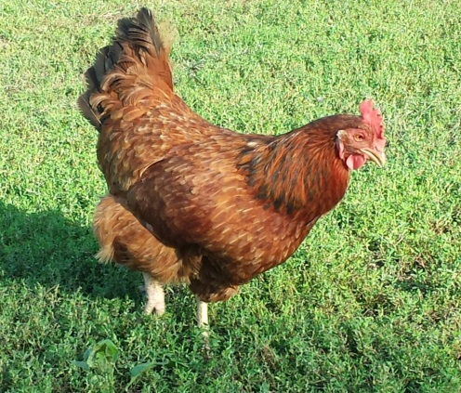
Emergency Containment
Large dog crates work fine for transport
As long as they have enough room to sit & not be on top of each other
For short term rescue standard large dog pens work
There is a pecking order, you may have to split the flock
You may or may not be able to mix birds from different flocks, probably not
If you think there will be a continuing problem I suggest slide 15
Dog dishes are fine for water
Dog pans are fine for food
Feeding on the concrete probably not a good idea
Straw
It is not absolutely necessary but a good idea, they will make a mess
They will need a laying box
Temporary roost are very easy to make with closet rods
Notes:
What do you kneed in a rescue situation - large dog crate work fine.
Dog cages - Note room fire capacity example.
Temporary roost – closet bar (wood) and shove it thru the wire cage holes about 3’ above the floor

Slide 9
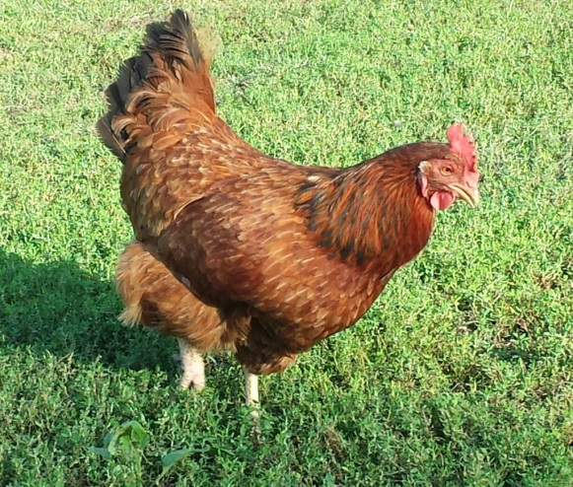
Care & Feeding
Importance of scratch and vegetation
Fiber, grit, protein, sunlight
Protein requirements (require 1,452 kcal ME/lb – 311 kcal / day)
Layers need 1.5 lb per bird per week or 24 oz = 3.43 oz per day, more in winter and molting
Summer layers need 14% protein, winter layers need 18% protein, 18% molting
Chicks require 2 or 3 pounds of feed per one pound of weight gain
Brown egg layers require about 18% more nutrients than white egg layers
Bugs & worms
A 3.5-ounce (100 g) serving of raw grasshoppers contains between 14 and 28 grams of protein, red ants supplies about 14 grams of protein, a giant water beetle about 20 grams of protein, June beetle supplies 13.4 grams, mealworms fresh 70 (20%) dried 185.5 (53%), 1 earthworm 7 grams of protein, fly pupae is 60% protein, locust 75% protein
Water
Layers require 2 lb water per 1 lb food, more in the summer (3 lb or 5.75 cups or 1½ qt / day) this is a very overlooked item
Notes:
100 grams is 3.5 oz. about 5 or 6 kernels of corn equal 1 gram.
Water collects mosquitoes, water must me changed twice per day.
Chickens are not vegetarians, they will kill and eat mice, snakes, each other.
Dust baths are important to their feathers.
Chickens get a lot of water from bugs and plants, they instinctively balance their own diets – corn example.
The US is one few countries that do not eat bugs, UN move to use bug production to feed poor countries, Jacob Wilson and Leamon story
Plywood strip feeding method

Slide 10
Pens & Coops
Pen sizes
What is an acceptable number of hens per yard? There are no standards
Average yards are ½ to ¾ acres, roughly the back yard will be 8,000 to 12,000 sf
By the French free range law that equates to 35 to 53 hens per yard –TO MANY
Our personal opinion is around 12 hens maybe 18 maximum in an urban yard or about 750 sf per bird (10 to 16 based upon sf) (with exceptions for acreage)
Coop sizes and designs
Coops – recommendations vary from 2 sf to 5 sf per bird
Nest – 16” x 16” x 16”, at least 2’ above the floor and dark
Shelter – must include shade
Pens – remember dogs, raccoons and foxes will dig under fences, cats will climb over, hawks can fly
Ventilation is a key factor in summer and they may need a heat lamp in the winter
Roost bars 1.5” dia and 24” above floor or higher, must be round not square
Notes:
First - The US has no regulations on free range or pasture raised, Europe does French are tightest regulations.
Coop design really boils down to how responsible the owner is.
Roost at different heights, different birds like different heights
Do not put roost bars above each other, birds will poop on the ones below them.

Slide 11
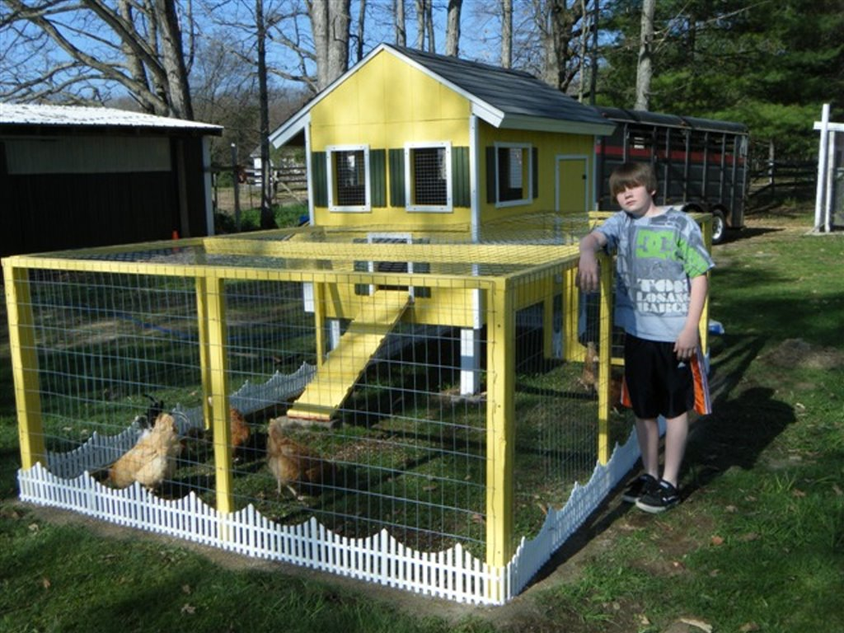
Good ventilation
Shade
Pen wire roof
Pen wire floor
Egg box
Good protection
Cute
To small for any extended amount of time
Tell me this isn’t cuter than any dog house in your city
Notes:
Chickens are like trailer houses & dogs.
Success of urban garden programs, this may be an application for vacant lots.
Way-Side-Waifs

Slide 12
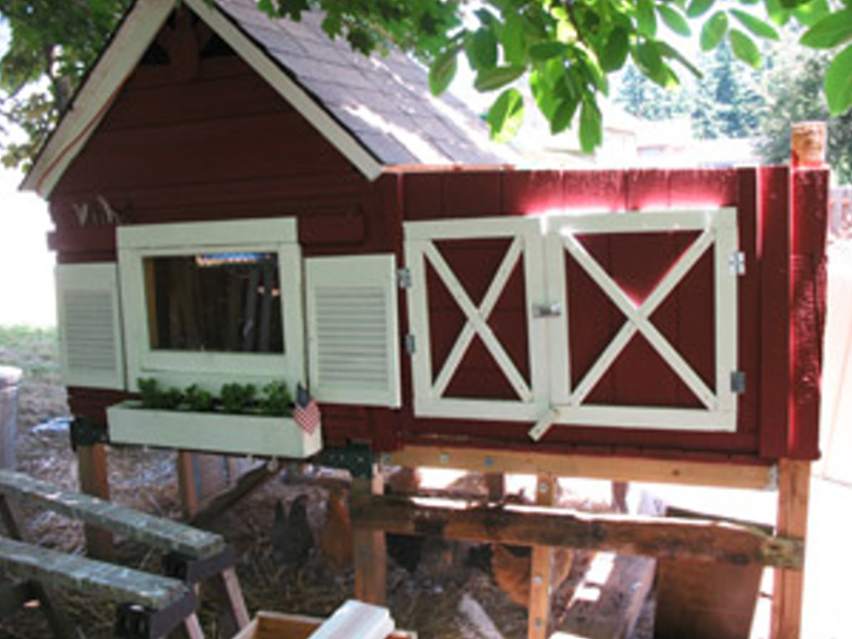
Good ventilation
Shade
Pen roof
Pen wire floor
Egg box
Good protection
Cute
To small for any extended amount of time

Slide 13
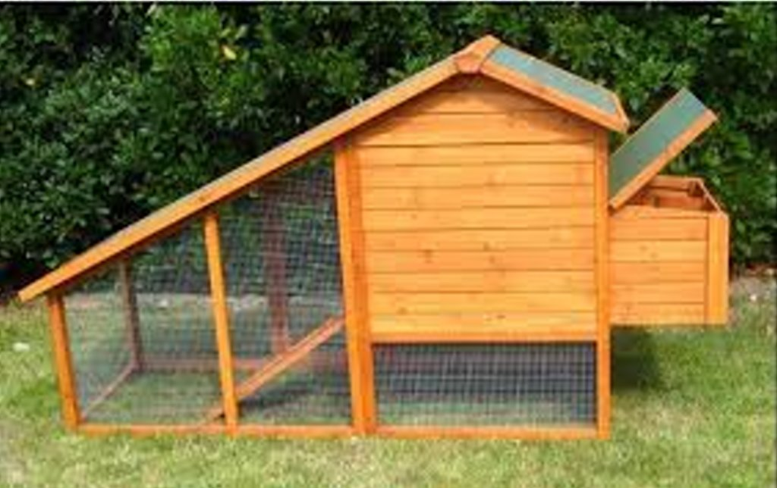
Shade
Pen wire roof
Pen wire floor
Egg box
Good protection
Moveable ?
No ventilation
To small for any extended amount of time

Slide 14
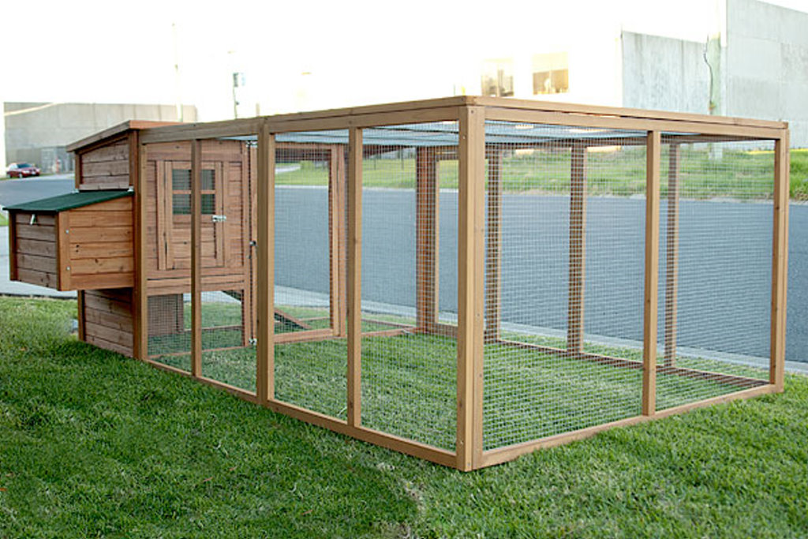
Good ventilation
Shade
Pen wire roof
Pen wire floor
Egg box
Good protection
Cute
Two section cage
Very good design, but should also have additional shade
Notes:
Suggested design for city rescue programs except with a larger housing area.
This is built in panels can be un-bolted and stored.
Cross brace the corners per my design.

Slide 15
Coop Detail Ideas
8’x8’ panels work great with 4’ wide wire and can be taken apart and stored in minimal space very quickly
Closet rod with hinged tops and wire support can be folded up to clean under, also gives the birds a choice of the height at which to roost

Slide 16
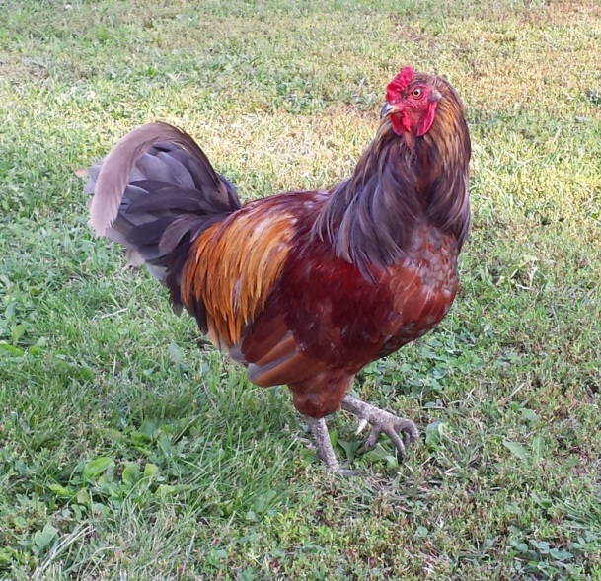
Good ventilation
Shade
Pen wire roof
Pen wire floor
Egg box
Good protection
Cute
Yard access also
The cost will be high
The Mother of all Great Designs
Notes:
With this exception all these chicken coops need access to the yard for forage.
They will de-forage these small coops in a few days.
Chickens will scratch out small flowers & plants

Slide 17
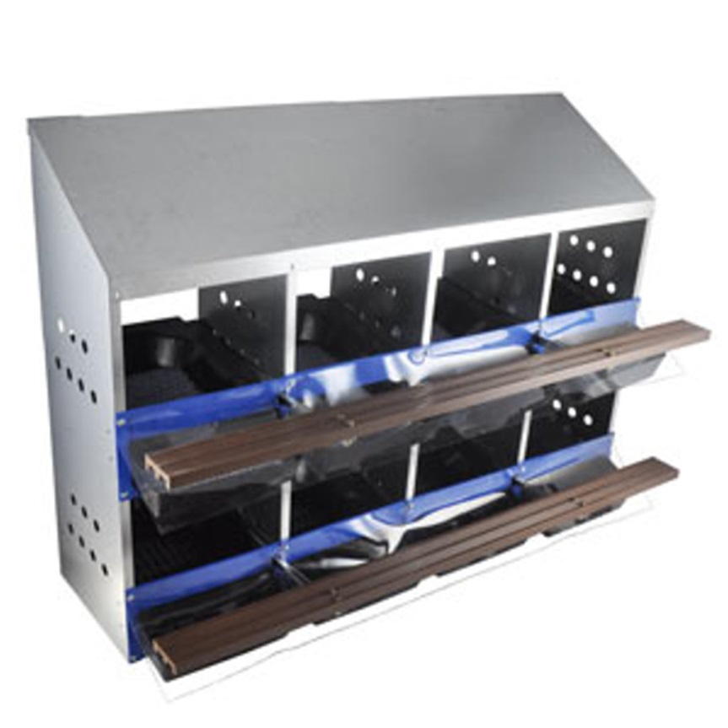
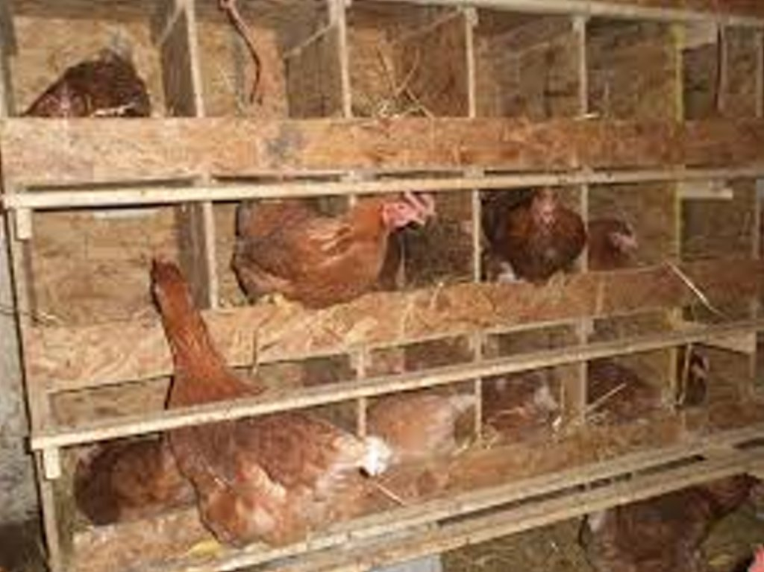
Nest Ideas
Typical commercial metal nest
Our nest 16 x 16 x 16
Notes:
Nest 16 x 16 x 16.
They need a bar in front of the nest.

Slide 18
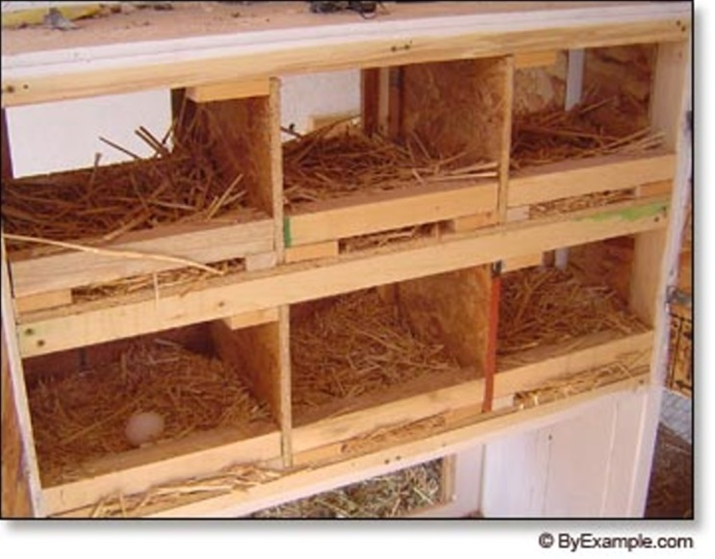
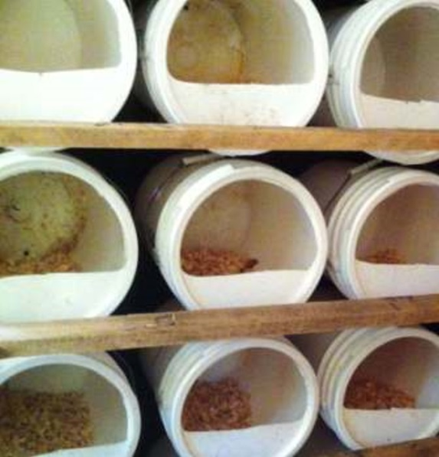
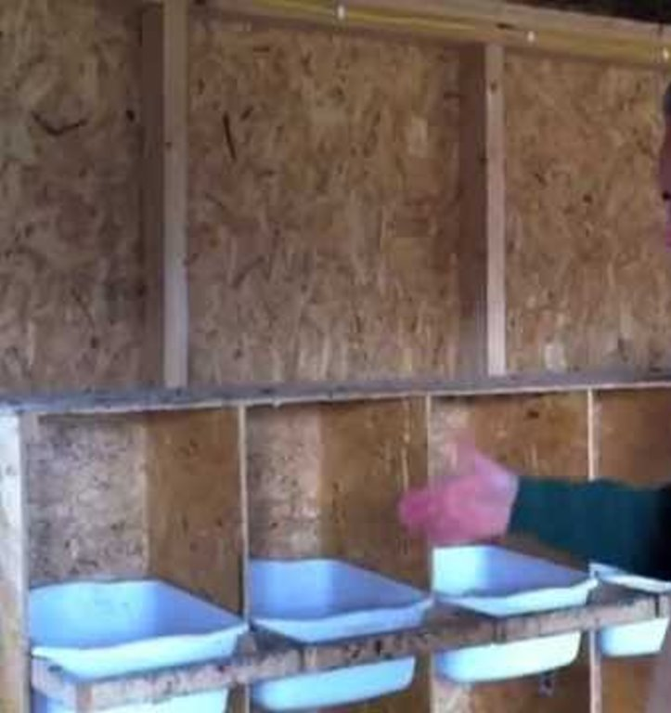
More Nest Ideas
Closet rod works great for roost and perches
Buckets and tubs can be taken out and cleaned
Chickens like to lay in the dark
Notes:
Perches should be 1¼” to 1½” and wooden, I have used PVC with success.

Slide 19
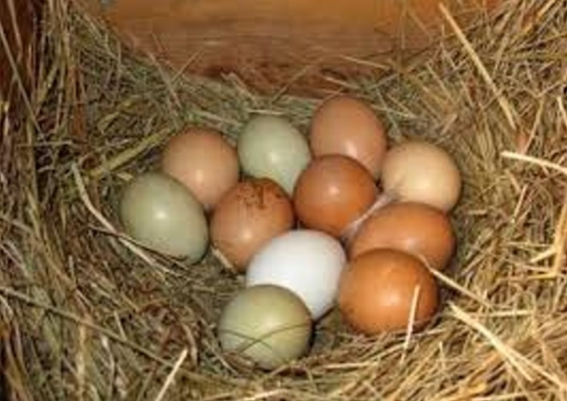
Eggs
Quality
1/3 less cholesterol, 1/4 less saturated fat, 2/3 more vitamin A, 2 times fore Omega-3, 3 times more vitamin E and 7 times more Beta carotene
Fertilized eggs – big controversy - yea or nay?
In Missouri producers can keep eggs 90 days before packaging once packaged stores have 30 days to sell them, they will keep about 30 more days – 5 mo total
Storage
US requires eggs to be washed destroying the “bloom” coating
In Europe it is illegal to wash eggs
Un-washed, fertilized eggs, refrigerated at 40 F will keep about 1 yr
All the old wife’ tales about storing eggs in lard, water, Vaseline, sand, sawdust, etc. do not work as well as un-washed refrigerated
Eggs need to be gathered daily, twice a day if it is over 100 degrees
Notes:
First - 6 billion eggs eaten in the US per year
You will get people asking why their eggs won’t hatch, no rooster

Slide 20
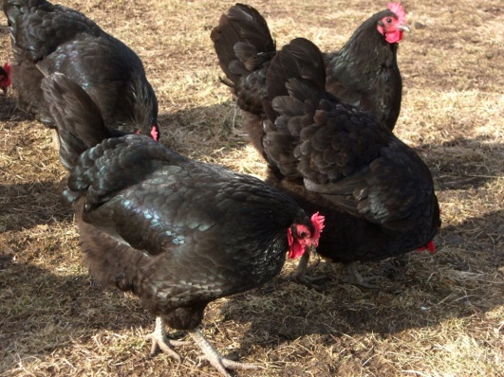
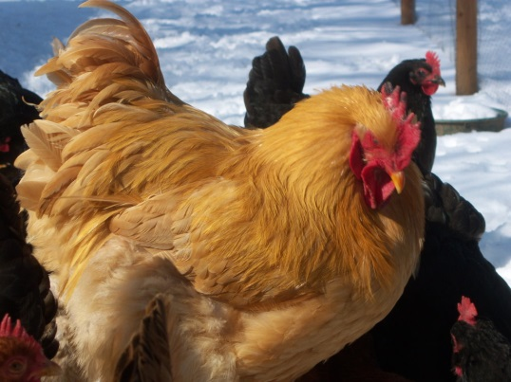
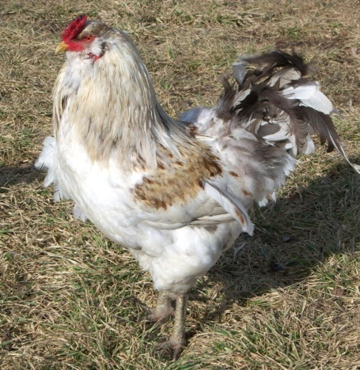
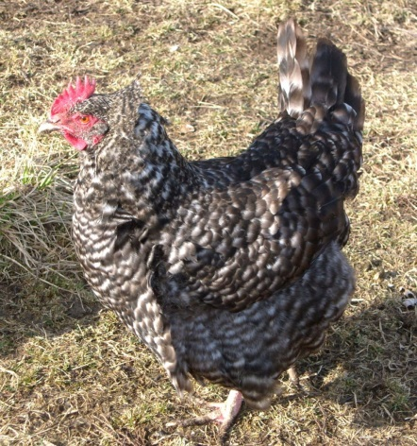
Chicken Breeds
Recommended
Jersey Giants – hardy, docile, don’t fly, great all round hens
Red and Black Sexlinks – good all round layers, very aggressive
Cochin – very docile, don’t fly
Barred Rock – hardy, docile, don’t fly, great all round hens
Problem breeds
Aracauna – only because they can fly over an 8’ fence
Bantam – are extremely susceptible to hawks, cats and other predators
Guineas – make lots of noise
Leghorns – bread for containment, not good as pets or back yards
Notes:
Hens live about 8 to 10 years.
They lay routinely for 5 to 7 years.
They are hatched with 900 eggs and will start to lay at about 6 months and lay 1 every other day.

Slide 21
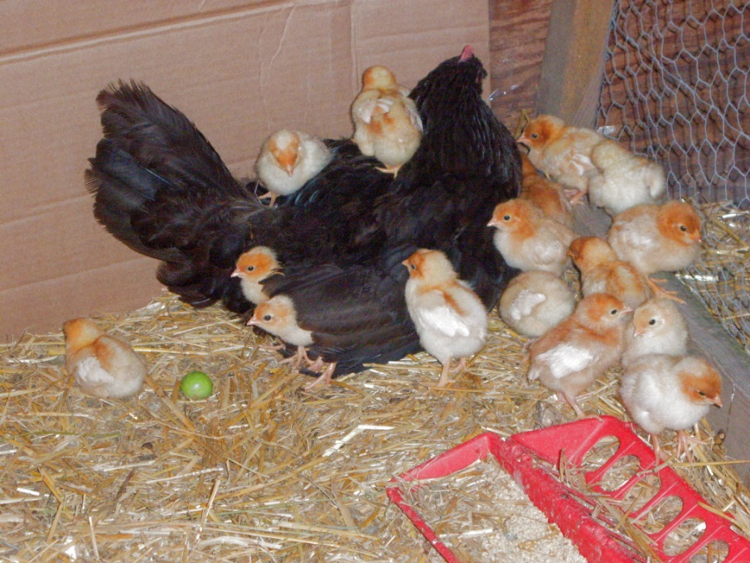
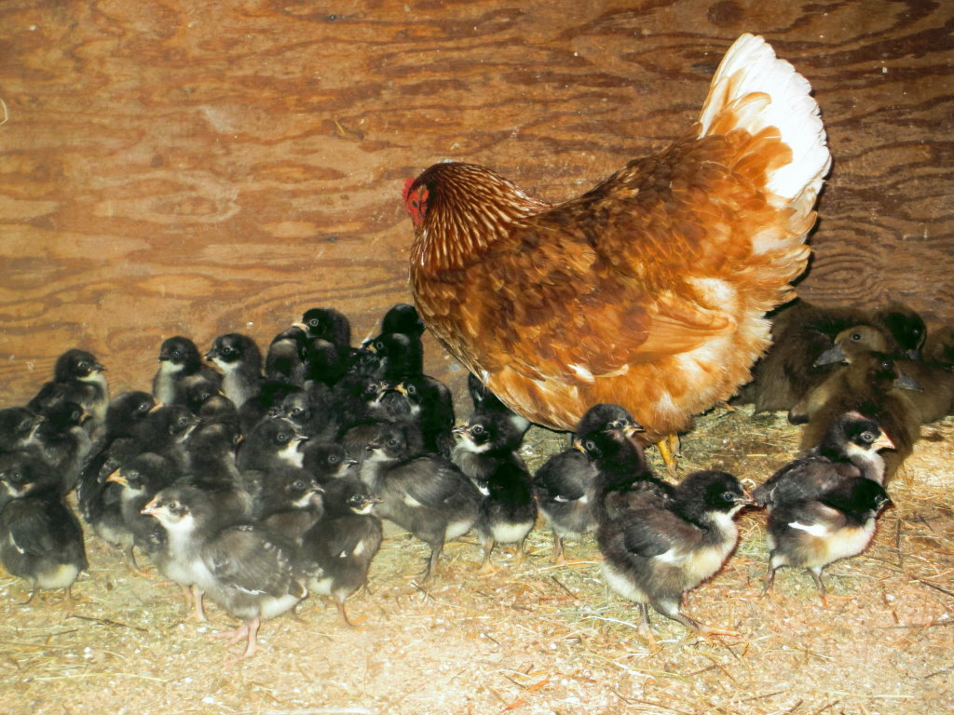
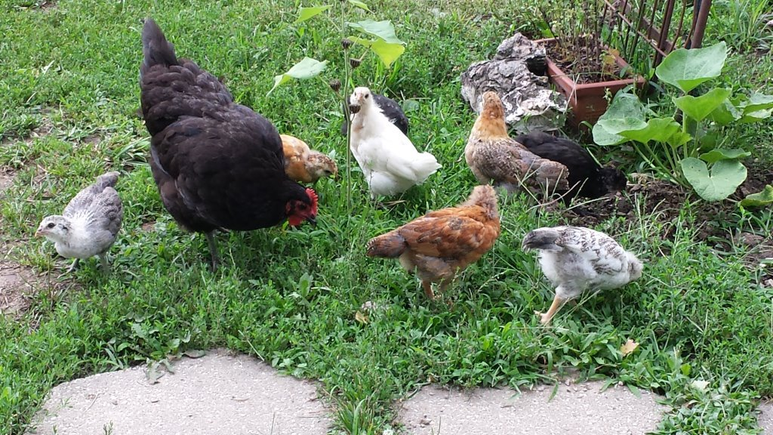
Other Tips
Never clip their beaks
Birds with clipped beaks cannot forage
If they are pecking each other you have to many chickens in to small a space or they are sick
Chickens can freeze their combs and feet
Notes:
Our rescues don’t know how to eat a worm.

Slide 22
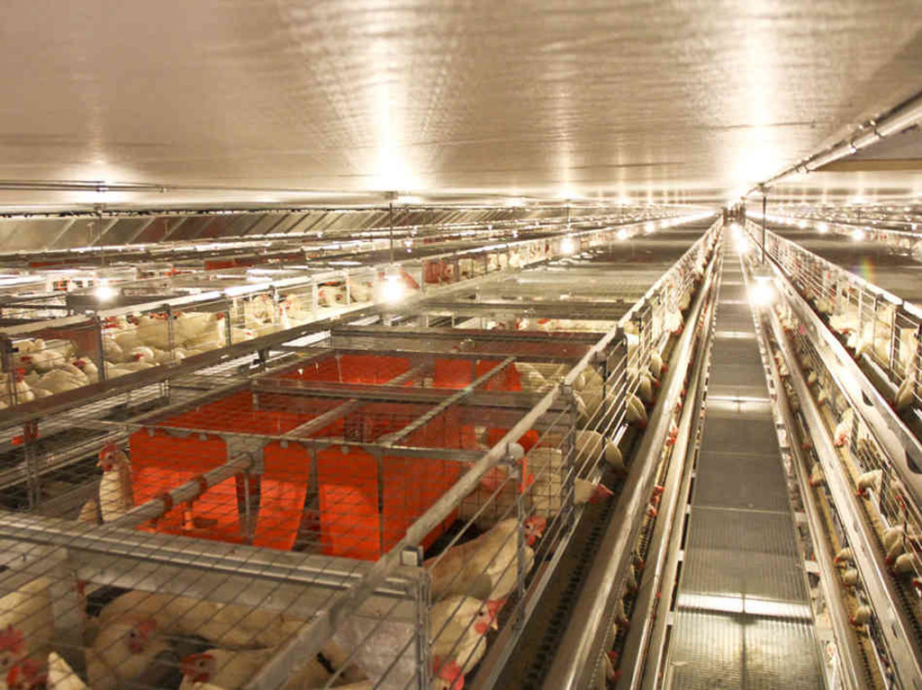
This is how your grocery store eggs are produced
No sunlight
No grass
No vegetation
No exercise
No bugs
Artificial everything
Life span 18 mo
Light controlled forced laying

Slide 23
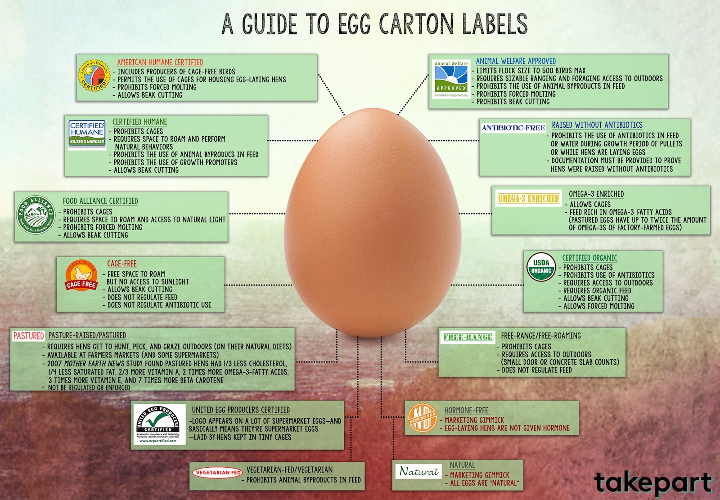
Notes:
Access to outdoors does not mean they ever go outdoors and they are not required to have vegetation.
Most of these allow beak cutting which means they have to many birds in a confined area and they cannot forage.
Most have no inspections basis and are simply marketing.
The only label in my opinion that is acceptable is “Animal Welfare Approved”.

Slide 24
IPM Integrated Pest Management
The use of trap crops, beneficial insects and chickens to control pest without the use of pesticides or with a greatly reduced use of pesticides.
Notes:
IPM is one of the driving forces behind urban chickens.
Chickens love bugs – ticks, crickets, roaches, ants, grasshoppers and especially June bugs.
2.4-D know as Agent Orange is now renamed and is being expedited for use to kill the plants that Roundup can no longer control due to it’s over use.
Over use of pesticides have now created species of pest that cannot be killed by chemical applications.
Over 1 billion pounds of pesticides and almost 5 billion pounds of herbicides sprayed each yr.
Box elder bug story.

Slide 25
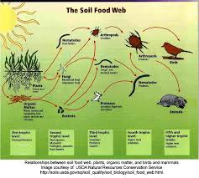
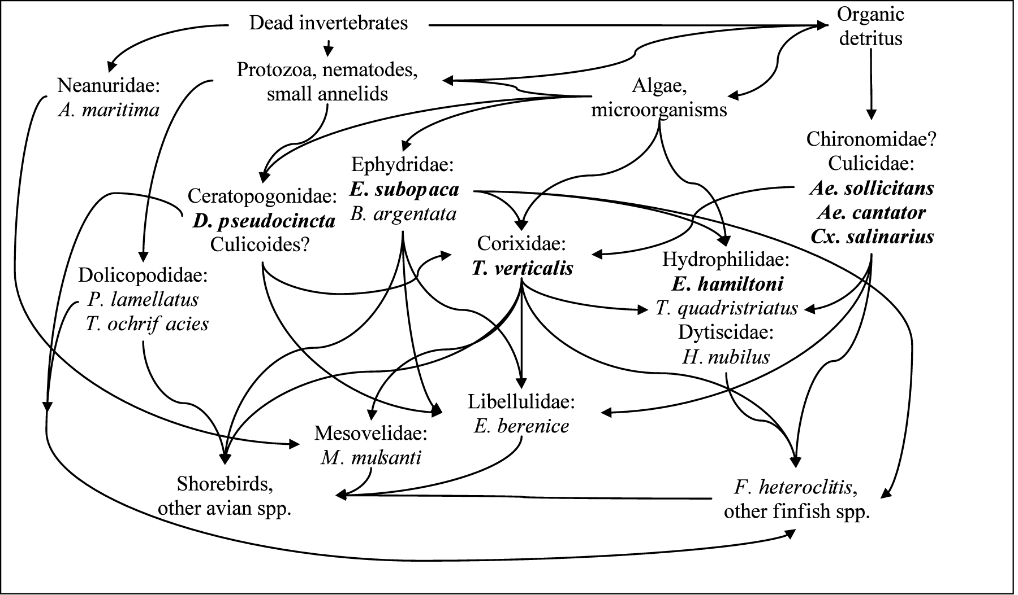
The Soil
Historically we believed there were around 225 microbes in a gram of soil new DNA analysis indicates there may be as many as 830,000 microbes in 1 gram of soil – killing just one group can kill them all
Notes:
Dirt, germs and manure are not inclusive, if you have healthy soil and healthy animals you have fertilizer not germs.
N-methyl-2-pyrrolidone -- an inert, or inactive, chemical commonly used as a pesticide additive -- is highly toxic to honeybee larvae.
Estimate is we lost 65% of the bees in the last two yr.

Slide 26
Urban Chickens by Rocky Creek Valley Farm
Copyright 2014
Gary & Elizabeth Wenig
www.rockycreekvalley.com
We grant the use of this presentation and rights to copy part or all of the presentation to all public educational institutions and government entities.
Questions & Comments

Slide 27
There are at least two hundred breeds and variations of domestic chickens on record, most though are extinct or rare.
There are more chickens on earth than there are people, over three billion in china alone.
The red Jungle fowl Gallus, Gallus is generally believed to be the ancestor of the modern domesticated chicken.
Recent evidence suggests that domestication of the chicken began in Vietnam over 10,000 years ago.
Chickens are the closest living relative of the tyrannosaur.
If you have a fear of chickens you may be Alektorophobic.
A chickens' heart beats at an amazing 280-315 beats a minute.
Studies show that chickens once thought as stupid are capable of complex thought.
Chickens enjoy dust bathing and become frustrated if they are prevented from doing so, such as in the close confinement of factory farmed battery hens.
In their natural environment Chickens are fastidiously clean and preen their feathers everyday.
Chickens are omnivores; this means they eat both vegetables and meat. In the wild, chickens eat grain, seeds, fruit, other vegetation, and insects, they often scratch at the soil to search for seeds and insects. Chickens like girt in their diet, which helps them to digest their food.

Slide 28
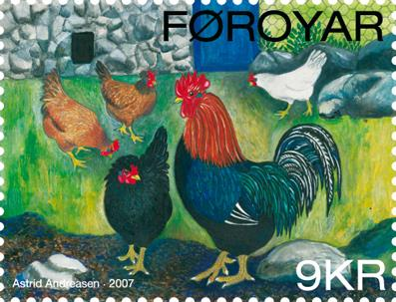
In the wild Chickens may live for five to eleven years however in the confinement of intensive farming, a meat chicken, called a broiler, generally lives only six weeks before slaughter and a hen lives only until she is spent, a term used to describe a hen who can no longer lay eggs. A free range or organic meat chicken will usually be slaughtered at about 14 weeks and also as with their factory farmed counterparts hens are slaughtered when they are spent.
In their natural environment Chickens live together as a flock. They have a communal approach to the incubation of eggs and raising of young.
Chickens have been depicted on postage stamps such as this one from the Faroe Islands issued 2007.
Chickens are good mothers In Ancient Rome the term "You were raised by a hen", was considered a compliment. As is a similar expression "Mother hen", which implies a chicken is a good mother as is the reference in the bible in Matthew 23:37 “How often I have longed to gather your children together, as a hen gathers her chicks under her wings, but you were not willing.” This is a metaphor eluding to the protective nature of a mother hen who reaches out to gather her chicks under her wings to shelter them and keep them safe.
Chickens are able to communicate with their mother whilst still in the egg and she with them. They can hear their mother's vocalizations and understand them after they are born.
Chickens are sociable animals, they form firm friendships preferring the company of chickens they know whilst avoiding those they do not.

Slide 29
Egg Lore
The most eggs laid by a chicken in one day is seven
The results from 14 studies of 14 different free-range facilities show TRUE free-range eggs are nutritionally superior compared to confined chicken eggs. More A, more D, more E, more omega 3, less saturated fat, less cholesterol.
It takes 4.5 pounds of feed for a chicken to produce a dozen eggs ( I have no idea how many bugs and worms there are to a pound and I don’t want to know) and it takes about three weeks for one hen to lay a dozen eggs.
Want to know what color egg a hen will lay? Look to the ear lobes! White lobes: white eggs. Tan/brown/red lobes: brown eggs. Blue/Green lobes: blue-green eggs This is a generalization as it will not always hold true.
Chickens have more bones in their necks than giraffes.
A hen is born (hatched) with all the eggs she will ever lay.
Howard Helmer, the Omelet King, is in the Guinness Book of World Records for making 427 two-egg omelets in 30 minutes.
EGG LORE: If you throw away half of an egg shell the fairies will find it and use it to sail across the sea to Ireland. Personally, I crush the shells and use them as a calcium source.

